Slide 1



DATASHIELDX
A DATA LOSS PREVENTION TOOL
R24-25J-003
23/10/2024
01

Slide 2








OUR TEAM
Supervisor
Co-supervisor
Mr. Amila Senarathne
Ms. Suranjini Silva
Senior Lecturer
Senior Lecturer
K.D.S.P Jayawickrama
P.P Liyanage
G.B.T.G Indrajith
H.A.N Nilakshana
IT21170720
IT21184758
IT21229220
IT21175602
Cyber Security
Cyber Security
Cyber Security
Cyber Security
R24-25J-003
23/10/2024
02

Slide 3


INTRODUCTION
This Data Loss Prevention (DLP) tool that incorporates advanced security features to protect sensitive data. The tool uses Homomorphic Encryption to allow secure data processing and classification without decryption, ensuring privacy.
It also provides defenses against brute force attacks and blocks malicious URLs, enhancing system security. Additionally, the tool includes a Steganographic Detection Module to uncover hidden data within files, preventing data leaks. Finally, its machine learning-powered Attention-Seeking Mode assigns risk scores to suspicious activities, helping prioritize security responses effectively.
R24-25J-003
23/10/2024
03

Slide 4

RESEARCH QUESTION
How can a Data Loss Prevention (DLP) tool, integrating homomorphic encryption, brute force attack mitigation, steganographic detection, and machine learning-based threat scoring, be developed to ensure secure data processing and effective threat detection in diverse environments?
R24-25J-003
23/10/2024
04

Slide 5


OBJECTIVES
Ensure Secure Data Processing: Implement homomorphic encryption to allow data classification and analysis without decrypting sensitive information.
Prioritize Threat Responses: Utilize machine learning to create an attention-seeking mode that assigns risk scores to suspicious activities, enabling efficient threat prioritization.
Prevent Unauthorized Access: Develop mechanisms to detect and block brute force attacks and malicious URLs, enhancing endpoint security.
Detect Covert Data Leaks: Integrate a steganographic detection module to identify hidden data within files and prevent data exfiltration.
R24-25J-003
23/10/2024
05
Notes:
5

Slide 6









Overall system diagram
End Point Devices
Web Traffic
Email/Documents
DLP Tool
Alerts & Reports
Attention-seeking mode with ML scoring
Homomorphic encryption
Brute Force Attack mitigation & URL blocking
Steganographic Detection
Database/Logs
Message extraction
R24-25J-003
23/10/2024
06
Cover image

Slide 7

Neelaka Nilakshana
IT21175602
H.A.N Nilakshana
BSc (Hons) in information Technology Specializing in cyber security
Mitigating Brute Force Attacks and browser security
Nilakshana H.A.N
IT21175602
R24-25J-003
23/10/2024
07
Notes:
7

Slide 8


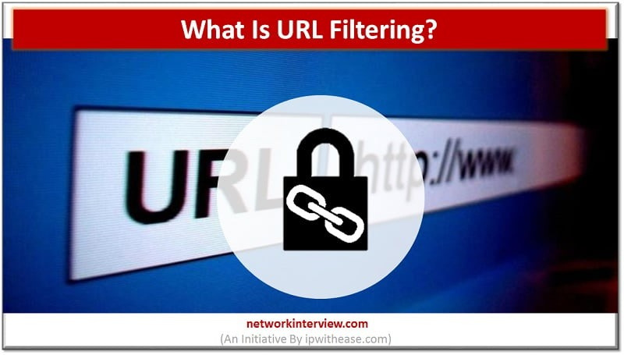
BACKGROUND
What is the Rate Limiting technique in mitigating brute force attacks?
Rate limiting is a security mechanism that restricts the number of attempts or requests made by a user or an IP address within a specified time frame. It is commonly used to mitigate brute force attacks by limiting login attempts and preventing malicious users from trying numerous password combinations in a short period.
Nilakshana H.A.N
IT21175602
R24-25J-003
23/10/2024
08
Notes:
8

Slide 9

RESEARCH QUESTION
how integrating rate limiting and URL filtering techniques can improve cybersecurity by defending against brute force attacks, focusing on balancing security and user experience ?
Integrating rate limiting and URL filtering enhances cybersecurity by slowing down brute force attacks and blocking malicious URLs, reducing attack success rates. This approach protects systems while minimizing disruptions for legitimate users, balancing security with a smooth user experience.
Nilakshana H.A.N
IT21175602
R24-25J-003
23/10/2024
09

Slide 10


RESEARCH GAP
Application References | Brute-force attack identification | URL blocking algorithm | URL blocking extension | Attack reporting system
Reference A
Reference B
Reference C
DATASHIELDX
Nilakshana H.A.N
IT21175602
R24-25J-003
23/10/2024
10

Slide 11



SPECIFIC AND SUB-OBJECTIVES
Specific Objective
Develop and evaluate a comprehensive security framework that integrates advanced rate limiting algorithms with dynamic URL filtering mechanisms to effectively mitigate brute force attacks while maintaining optimal system performance and minimizing false positive.
Sub Objective
Develop an advanced rate limiting model.
Implement dynamic URL filtering.
Evaluate the integrated system's performance.
Test the solution in real-world environments.
Nilakshana H.A.N
IT21175602
R24-25J-003
23/10/2024
11

Slide 12

METHODOLOGY
Data Collection and Analysis
Develop Rate Limiting Algorithm
Implement URL Filtering Mechanism
Integration of Security Measures:
Performance Evaluation:
Real-World Testing:
Documentation and Reporting
Nilakshana H.A.N
IT21175602
R24-25J-003
23/10/2024
12

Slide 13











TOOLS AND TECHNOLOGIES
OpenCV
Google Collab
Flask
TensorFlow
VScode
Scikit-learn
Python
Github
Numpy
R24-25J-003
08/08/2024
Nilakshana H.A.N
IT21175602
R24-25J-003
23/10/2024
01
13

Slide 14

COMPLETION OF THE PROJECT
Implementation:
Coding and Development: Utilize Python to implement an advanced rate limiting algorithm and dynamic URL filtering system, ensuring effective mitigation of brute force attacks and malicious URL access.
Testing and Evaluation:
Test the integrated security framework against simulated and real-world brute force attack scenarios. Evaluate its performance using metrics like detection rate, false positive rate, and user impact. Compare results with existing security measures and conduct a thorough analysis of any vulnerabilities.
Outcomes:
Achieve enhanced protection against brute force attacks and reduced false positives through the integration of advanced rate limiting and dynamic URL filtering. Demonstrate the effectiveness of the framework in real-world cybersecurity scenarios.
Nilakshana H.A.N
IT21175602
R24-25J-003
23/10/2024
14

Slide 15

REFERENCES
Orozco-Fonseca, D., Marín, G., & Lara, A. (2024). Taxonomy of malicious URL detection Techniques. In Lecture notes in networks and systems (pp. 73–81). https://doi.org/10.1007/978-3-031-54235-0_7
Mok, K. H., & Kyu, A. P. (2020). Web-based brute force attack blocking device and method using machine learning. SciSpace - Paper. https://typeset.io/papers/web-based-brute-force-attack-blocking-device-and-method-4uiuro3jv3
Nowroozi, E., Abhishek, N., Mohammadi, M., & Conti, M. (2022). An Adversarial attack analysis on Malicious Advertisement URL Detection Framework. IEEE Transactions on Network and Service Management, 20(2), 1332–1344. https://doi.org/10.1109/tnsm.2022.3225217
Nilakshana H.A.N
IT21175602
R24-25J-003
23/10/2024
15

Slide 16
Sulaksha Punsara
IT21170720
K.D.S.P Jayawickrama
BSc (Hons) in information Technology Specializing in cyber security
Homomorphic Encryption for Data Processing
Jayawickrama K.D.S.P
IT21170720
R24-25J-003
23/10/2024
16
Notes:
16

Slide 17

BACKGROUND
Homomorphic encryption enables secure data processing by allowing computations on encrypted data without decryption, addressing privacy concerns in various sensitive fields. However, it struggles with large files, necessitating a solution that combines data classification to effectively manage smaller, sensitive data. This integration enhances data security and ensures compliance with privacy regulations while facilitating secure analysis and processing of critical information.
Jayawickrama K.D.S.P
IT21170720
R24-25J-003
23/10/2024
17

Slide 18
RESEARCH QUESTION
How can homomorphic encryption be integrated with data classification to ensure secure processing of sensitive data in a DLP tool, especially when large files cannot be encrypted?
Homomorphic encryption can be integrated with data classification in a DLP tool by first identifying and prioritizing sensitive, smaller data for encryption while segmenting larger files for alternative protection. This allows for secure computations on encrypted data without exposure, ensuring compliance and privacy. By implementing a centralized monitoring system, we can efficiently manage encrypted and non-encrypted data, enhancing overall data security.
Jayawickrama K.D.S.P
IT21170720
R24-25J-003
23/10/2024
18

Slide 19
RESEARCH GAP
Application References | Exploration of Processing Encrypted Data | Data Classification | Homomorphic Encryption in DLP Tools | Large File Processing
Reference [1]
Reference [2]
Reference [3]
DATASHIELDX
Jayawickrama K.D.S.P
IT21170720
R24-25J-003
23/10/2024
19

Slide 20

SPECIFIC AND SUB-OBJECTIVES
Specific Objective
The primary objective of the "Homomorphic Encryption for Data Processing" component is to enhance data security by enabling secure computations on sensitive data without the need for decryption. This involves implementing a robust data classification system that prioritizes and manages smaller, sensitive data sets effectively. The goal is to protect privacy while allowing effective data analysis within a Data Loss Prevention (DLP) tool, ensuring compliance with relevant regulations.
Sub Objective
Implement Data Classification
Ensure Efficient Data Processing
Integrate with DLP Tool
Jayawickrama K.D.S.P
IT21170720
R24-25J-003
23/10/2024
20

Slide 21
METHODOLOGY
Data Classification Framework
Homomorphic Encryption Implementation
Integration with DLP Tool
Testing and Evaluation
Jayawickrama K.D.S.P
IT21170720
R24-25J-003
23/10/2024
21

Slide 22




TOOLS AND TECHNOLOGIES
Helib
Google Collab
Node.js
TensorFlow
VScode
TenSeal
Python
Github
Numpy
Jayawickrama K.D.S.P
IT21170720
R24-25J-003
23/10/2024
22

Slide 23
COMPLETION OF THE PROJECT
Implementation:
Coding and Development: Utilize Python to implement homomorphic encryption algorithms and create a data classification framework, ensuring sensitive data is categorized effectively.
Testing and Evaluation:
Performance Assessment: Conduct tests to evaluate processing speed, accuracy of data classification, and the effectiveness of homomorphic encryption in maintaining data security.
Outcomes:
Functional DLP Tool: Deliver a fully functional DLP tool that processes sensitive data securely, leveraging homomorphic encryption while ensuring data integrity.
Enhanced Security and Compliance: Achieve improved data security and efficient analysis capabilities, demonstrating compliance with established data protection standards.
Jayawickrama K.D.S.P
IT21170720
R24-25J-003
23/10/2024
23

Slide 24
REFERENCES
A. Gupta, "Data Loss Prevention," in *IEEE Computer Society Data*, 2009. [Online]. Available: https://www.researchgate.net/publication/224127741_Data_Loss_Prevention. [Accessed: Oct. 23, 2024].
J. Smith and K. Patel, "Cybersecurity Technology Strategic Plan for Data Loss Prevention," in *Proceedings of the International Conference on Cybersecurity Strategies*, 2023. [Online]. Available: https://www.researchgate.net/publication/377822490_Cybersecurity_Technology_Strategic_Plan_for_Data_Loss_Prevention. [Accessed: Oct. 23, 2024].
M. Brown and R. Jones, "A Survey on Balancing Data Loss Prevention (DLP) with User Privacy in a Data-Driven World," in *Journal of Information Security*, 2024. [Online]. Available: https://www.researchgate.net/publication/383187137_A_Survey_on_Balancing_Data_Loss_Prevention_DLP_with_User_Privacy_in_a_Data-Driven_World. [Accessed: Oct. 23, 2024].
Jayawickrama K.D.S.P
IT21170720
R24-25J-003
23/10/2024
24
Notes:
24

Slide 25
Tharindu Gihan
IT21229220
G.B.T.G Indrajith
BSc (Hons) in information Technology Specializing in cyber security
Stego Images Detection
Indrajith G.B.T.G
IT21229220
R24-25J-003
23/10/2024
25

Slide 26
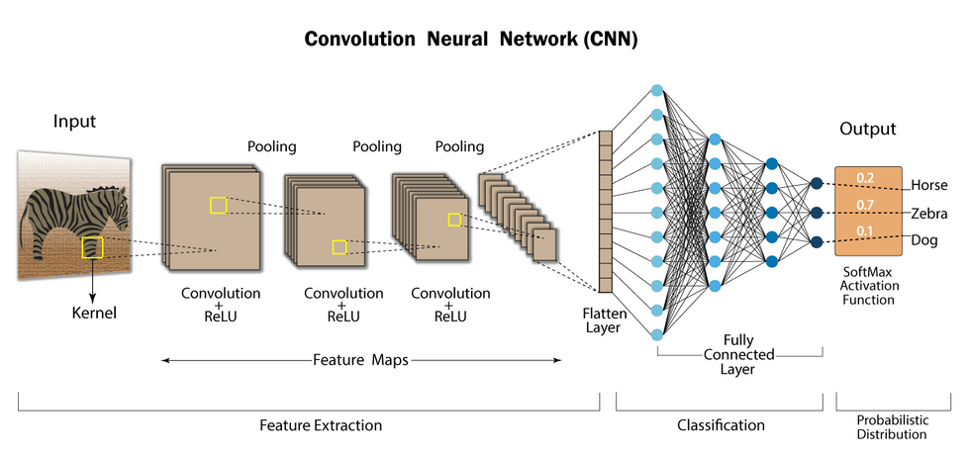

BACKGROUND
What is steganalysis?
The process of detecting hidden messages embedded in digital files like images or videos.
How do Dual-CNN Models Help in Steganalysis?
They analyze images at fine and coarse scales, improving detection accuracy through feature fusion.
Why is Real-Time Detection Important?
It blocks hidden data transfers immediately, preventing data leaks.
What is Spatial vs. Frequency Domain Steganography?
Spatial: Hides data by altering pixel values (e.g., LSB).
Frequency: Hides data by modifying frequency components (e.g., DCT).
Indrajith G.B.T.G
IT21229220
R24-25J-003
23/10/2024
26
Notes:
26

Slide 27
RESEARCH QUESTION
How can dual-CNN models with feature fusion be utilized to enhance the detection of steganographic content within a Data Loss Prevention (DLP) tool?
This research question focuses on exploring how the integration of two CNN models operating at fine and coarse scales, along with feature fusion, can improve the accuracy and efficiency of steganalysis. It aims to address real-time detection challenges, reduce false positives, and enhance the overall effectiveness of DLP systems in preventing data exfiltration through hidden content in images.
Indrajith G.B.T.G
IT21229220
R24-25J-003
23/10/2024
27
Notes:
27

Slide 28
RESEARCH GAP
Application References | Real-Time detection | DLP integration | Multi-scale CNN utilization | High detection accuracy
Reference A
Reference B
Reference C
DATASHIELDX
Indrajith G.B.T.G
IT21229220
R24-25J-003
23/10/2024
28

Slide 29

SPECIFIC AND SUB-OBJECTIVES
Specific Objective
To enhance the accuracy of steganographic content detection by developing a dual-CNN feature fusion model and integrating it within a Data Loss Prevention (DLP) tool for real-time threat prevention.
Sub Objective
Design and Train Fine-Scale and Coarse-Scale CNN Models
Implement Feature Fusion Mechanism
Develop Real-Time Detection Capabilities
Create Automated Alerting and Reporting System
Deploy User-Friendly Dashboard for Visualization
Indrajith G.B.T.G
IT21229220
R24-25J-003
23/10/2024
29

Slide 30
METHODOLOGY
Dataset Selection and Preprocessing
Development of Dual-CNN Models
Algorithm Implementation and Testing
Integration with DLP System
Performance Evaluation and Optimization
Indrajith G.B.T.G
IT21229220
R24-25J-003
23/10/2024
30

Slide 31
TOOLS AND TECHNOLOGIES
OpenCV
Google Collab
Node.js
TensorFlow
VScode
Scikit-learn
Python
Github
Numpy
Indrajith G.B.T.G
IT21229220
R24-25J-003
23/10/2024
31

Slide 32
COMPLETION OF THE PROJECT
Implementation:
Develop and integrate dual-CNN models within the DLP system.
Implement feature fusion for enhanced detection accuracy.
Enable real-time detection and automatic blocking of stego images.
Testing and Evaluation:
Test with datasets like ALASKA2 and BOSSBase to ensure performance.
Improv detection accuracy and reduced false positives.
Validate real-time blocking and alert notifications.
Outcomes:
Achieve robust steganography detection with better accuracy.
Successfully prevent hidden data transmission through real-time blocking.
Enhanced overall security within the DLP system.
Indrajith G.B.T.G
IT21229220
R24-25J-003
23/10/2024
32

Slide 33
REFERENCES
[1] Progonov, D. (2023b). Destruction of stego images formed by adaptive embedding methods with dictionary learning methods. Theoretical and Applied Cybersecurity, 4(1). https://doi.org/10.20535/tacs.2664-29132022.1.254883
[2] De La Croix, N. J., & Ahmad, T. (2023a). Toward secret data location via fuzzy logic and convolutional neural network. Egyptian Informatics Journal, 24(3), 100385. https://doi.org/10.1016/j.eij.2023.05.010
[3] Hidayasari, N., Riadi, I., & Prayudi, Y. (2020b). Steganalysis Using Yedrodj-net net’s Convolutional Neural Networks (CNN) Method on Steganography Tools. Proceeding International Conference on Science and Engineering, 3, 207–211. https://doi.org/10.14421/icse.v3.499
Indrajith G.B.T.G
IT21229220
R24-25J-003
23/10/2024
33

Slide 34
Pubudu Liyanage
IT21184758
P.P Liyanage
BSc (Hons) in information Technology Specializing in cyber security
Attention-Seeking Mode with a Score System Using Machine Learning
Liyanage P.P
IT21184758
R24-25J-003
23/10/2024
34

Slide 35
BACKGROUND
Introduction:
In modern cybersecurity environments, Data Loss Prevention (DLP) systems are critical for detecting and preventing potential data breaches. However, the sheer volume of alerts generated by these systems can overwhelm security teams.
Importance:
High Alert Volumes: DLP systems often trigger numerous alerts daily, many of which are low priority.
Alert Fatigue: Security teams struggle to manage and prioritize alerts, leading to missed or delayed responses to critical threats.
Efficiency Challenge: There is a growing need for intelligent systems that can prioritize alerts, reducing the cognitive load on analysts and improving incident response times.
Liyanage P.P
IT21184758
R24-25J-003
23/10/2024
35

Slide 36
RESEARCH QUESTION
How can machine learning be leveraged to implement an attention-seeking mode that intelligently prioritizes DLP security alerts based on their potential risk?
"Machine learning can be applied to DLP systems by analyzing historical incident data and assigning risk scores to alerts. This enables the system to prioritize high-risk alerts, reducing alert fatigue and allowing security teams to respond more effectively to critical threats."
Liyanage P.P
IT21184758
R24-25J-003
23/10/2024
36

Slide 37
RESEARCH GAP
Application References | Real-time Risk Scoring | Alert Fatigue Reduction | Historical Data Analysis | Critical Incident Prioritization
Reference [1]
Reference [2]
Reference [3]
DATASHIELDX
Liyanage P.P
IT21184758
R24-25J-003
23/10/2024
37

Slide 38

SPECIFIC AND SUB-OBJECTIVES
Specific Objective
Develop a machine learning-based system to prioritize security alerts based on their risk scores.
Sub Objective
Analyze historical security incident data to identify key features.
Build a model to assign risk scores to alerts.
Evaluate system performance in reducing alert fatigue.
Liyanage P.P
IT21184758
R24-25J-003
23/10/2024
38

Slide 39
METHODOLOGY
Data Collection: Collect historical incident and alert data from DLP systems.
Feature Engineering: Identify key factors that contribute to alert risk.
Modeling: Use machine learning algorithms to assign risk scores.
Testing: Evaluate the model with real-world or simulated alert data.
Optimization: Fine-tune based on feedback and results.
Liyanage P.P
IT21184758
R24-25J-003
23/10/2024
39

Slide 40
TOOLS AND TECHNOLOGIES
OpenCV
Google Collab
Node.js
TensorFlow
VScode
Scikit-learn
Python
Symantec
Numpy
Liyanage P.P
IT21184758
R24-25J-003
23/10/2024
40

Slide 41
COMPLETION OF THE PROJECT
Completion Plan:
Data Gathering & Analysis: Focus on collecting sufficient and diverse alert data.
Model Training: Develop and train the machine learning model for prioritizing alerts.
System Testing: Test on real or simulated environments to gauge effectiveness.
Final Review & Refinement: Make necessary adjustments based on performance metrics and user feedback.
Documentation & Reporting: Finalize the report and results.
Liyanage P.P
IT21184758
R24-25J-003
23/10/2024
41

Slide 42
REFERENCES
O. Keskin, N. Gannon, B. Lopez and U. Tatar, "Scoring Cyber Vulnerabilities based on Their Impact on Organizational Goals," 2021 Systems and Information Engineering Design Symposium (SIEDS), Charlottesville, VA, USA, 2021, pp. 1-6, doi: 10.1109/SIEDS52267.2021.9483741.
E. Seker and W. Meng, "XVRS: Extended Vulnerability Risk Scoring based on Threat Intelligence," 2023 IEEE International Conference on Metaverse Computing, Networking and Applications (MetaCom), Kyoto, Japan, 2023, pp. 516-523, doi: 10.1109/MetaCom57706.2023.00094.
M. Keramati, "New Vulnerability Scoring System for dynamic security evaluation," 2016 8th International Symposium on Telecommunications (IST), Tehran, Iran, 2016, pp. 746-751, doi: 10.1109/ISTEL.2016.7881922.
Liyanage P.P
IT21184758
R24-25J-003
23/10/2024
42

Slide 43

COMMERCIALIZATION
Market demand:
The growing need for data security across industries highlights the importance of a robust Data Loss Prevention (DLP) tool. Organizations require advanced solutions that protect sensitive data from unauthorized access, hidden threats like steganography, and various cyberattacks. The demand spans sectors such as healthcare, finance, and government, where compliance and data privacy are paramount.
Value proposition:
For Government Agencies:
Our DLP tool offers enhanced security through real-time detection of hidden data, such as steganographic content, and prevents brute force attacks and unauthorized access to classified information. This ensures national security is maintained, and sensitive data remains secure.
For Private Sector & Enterprises:
With features like homomorphic encryption for secure data processing, URL blocking, and machine learning-driven threat prioritization, businesses can improve data protection and compliance with regulations such as HIPAA and GDPR. This helps prevent data breaches and keeps sensitive information safe.
Go-to-market strategy:
We plan to partner with cybersecurity firms, enterprises, healthcare organizations, and government bodies to integrate our DLP tool into their existing security frameworks. By offering demonstrations and real-world case studies, we aim to show the tool's effectiveness in preventing data breaches, detecting hidden threats, and improving compliance.
Competitive advantage:
Our DLP tool employs a multi-layered approach, combining homomorphic encryption, brute force attack mitigation, steganographic detection, and machine learning-based threat scoring. This unique combination provides comprehensive data security, making it an essential tool in the modern data protection landscape.
R24-25J-003
23/10/2024
43

Slide 44
THANK YOU !
R24-25J-003
23/10/2024
44

Slide 45
ANY QUESTIONS?
R24-25J-003
23/10/2024
45

